Slide 1
Carnival
..and Carnival traditions in Poland

Slide 2
About Carnival
Carnival, known as old Polish ‘zapusty’, in Poland is a time from New Year to Ash Wednesday.
The name comes from the Latin-Italian word - "Carnavale". It means parting with meat for lent time in Poland, translated "mięsopust", specifying the last days of the carnival.

Slide 3
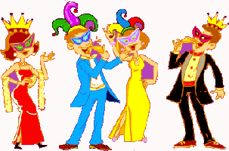
About Carnival
In the Middle Ages Carnival was famous in Venice and in the eighteenth century - in Rome. It was almost as uproariously celebrated at that time in Spain, Portugal and France; people liked partying also in Germany, the Czech Republic, in Russia and the Balkans.

Slide 4
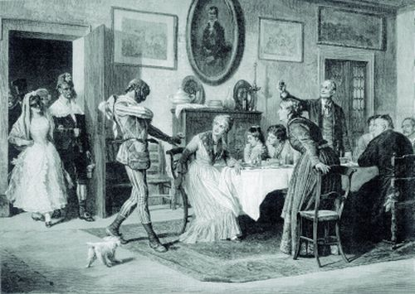
Carnival Traditions
Especially in wealthy homes during the carnival held sumptuous feasts and balls. It was a kind of marital exchange for well-born young ladies who danced under the watchful eyes of mothers, grandmothers and aunts.

Slide 5
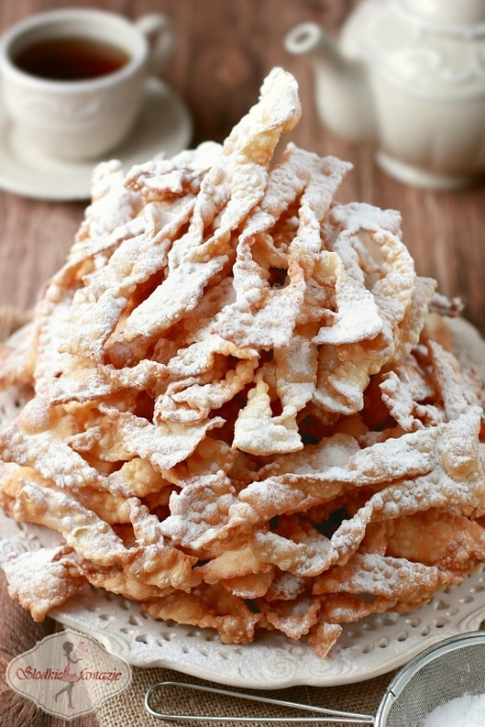
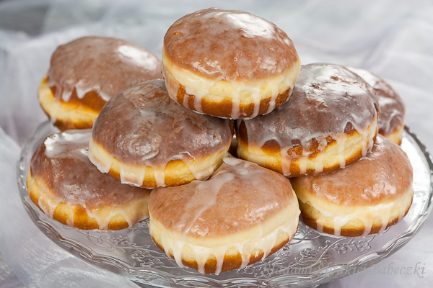
Carnival Traditions
One of the Polish tradition is Shrove Tuesday. It's a day in which on any of Polish tables can not miss the delicious donuts. This is an introduction to the last frenzy before Ash Wednesday

Slide 6
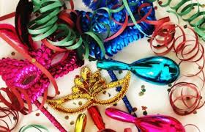
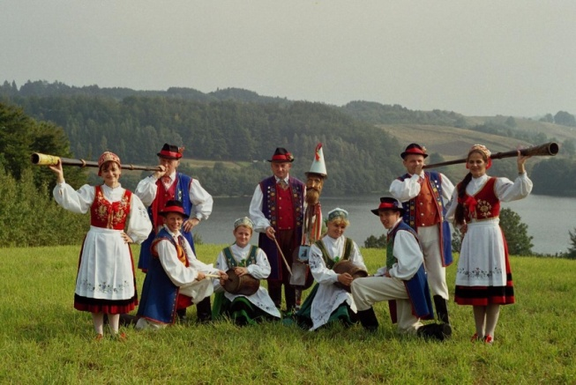
Traditions in Kaszuby
In the Kashubian region people ate a lot of greasy dishes, as if to satisfy their hunger before Lent. Very poor people tried to eat some meat because they believed this saying ‘who doesn't eat meat, mosquitoes will "eat" him in the summer’. Kashubian carnival traditions are very varied, and many of them have survived to the present day.

Slide 7
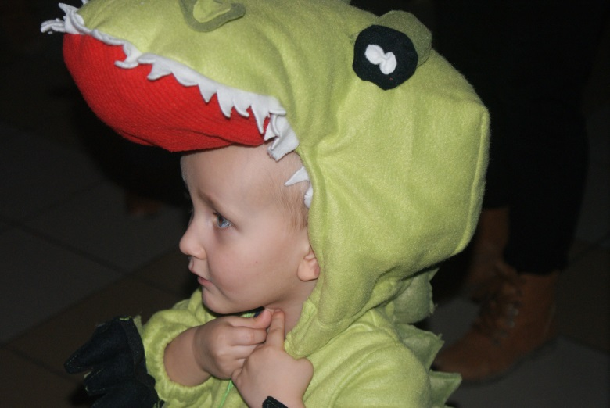
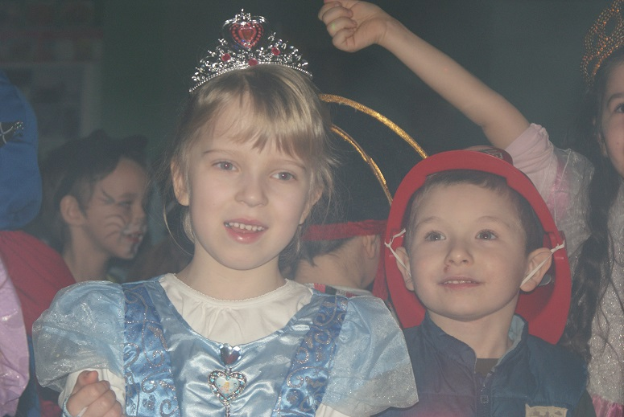
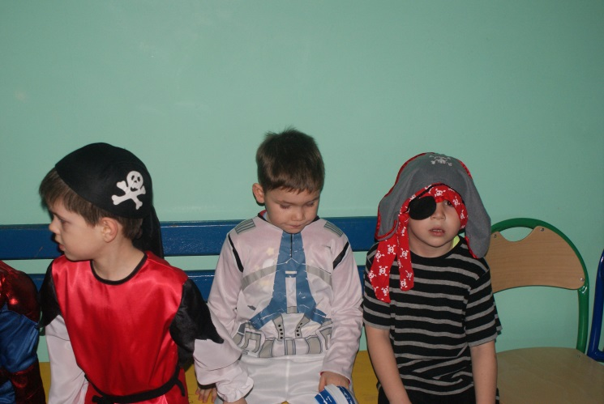
Carnivals at schools
At the present time are held very fashionable carnival balls for children at schools. Teachers organize a variety of games and competitions in the rhythm of music. Children dress up as their favorite characters from fairy tales or favorite heros.

Slide 8
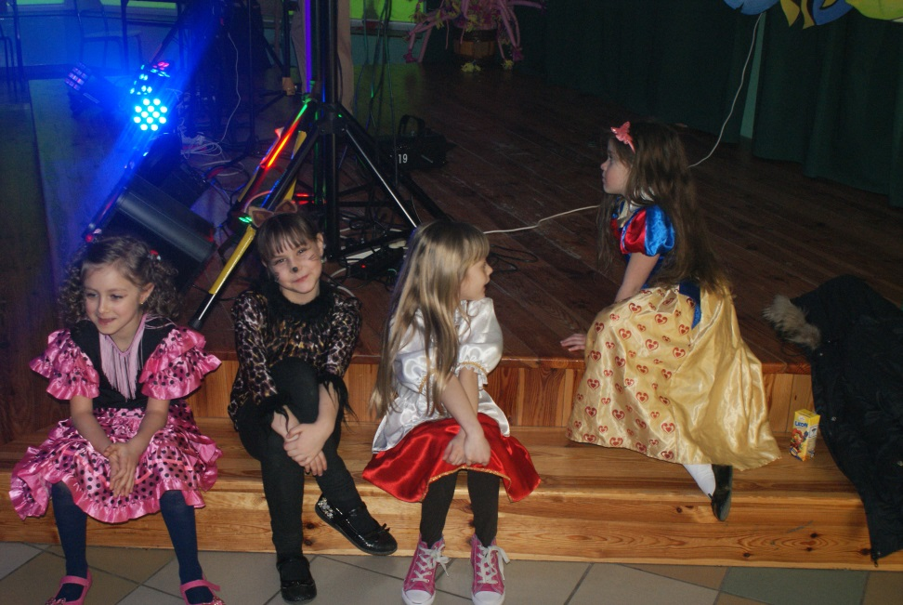
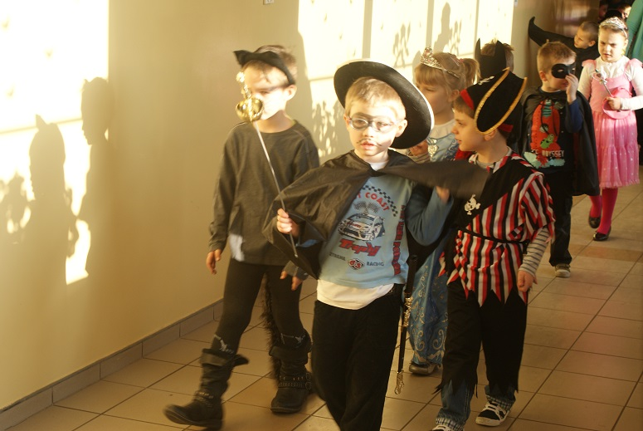
Carnival in our school
In our school also took place carnival fun. Children played in the rhythm of disco music. They dressed up as their favorite characters and had great fun.

Slide 9
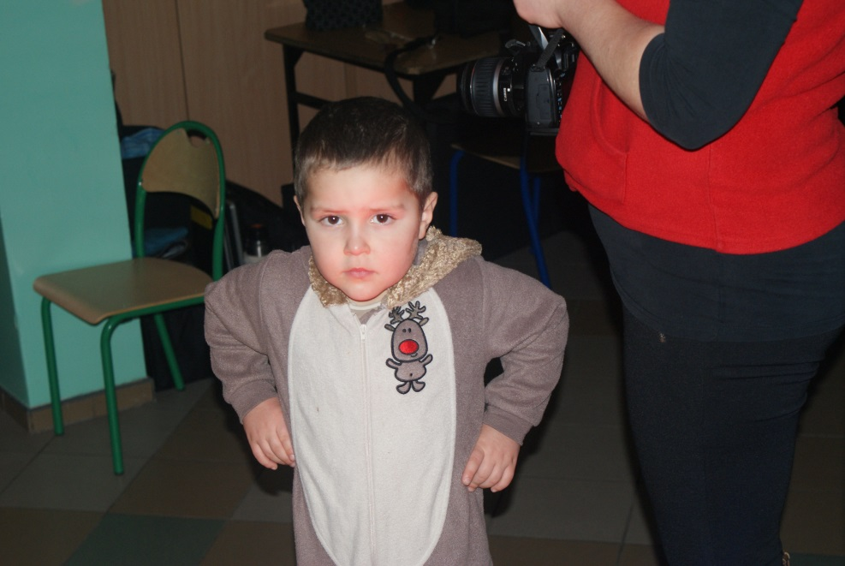
And now, little show of our fun ☺

Slide 10
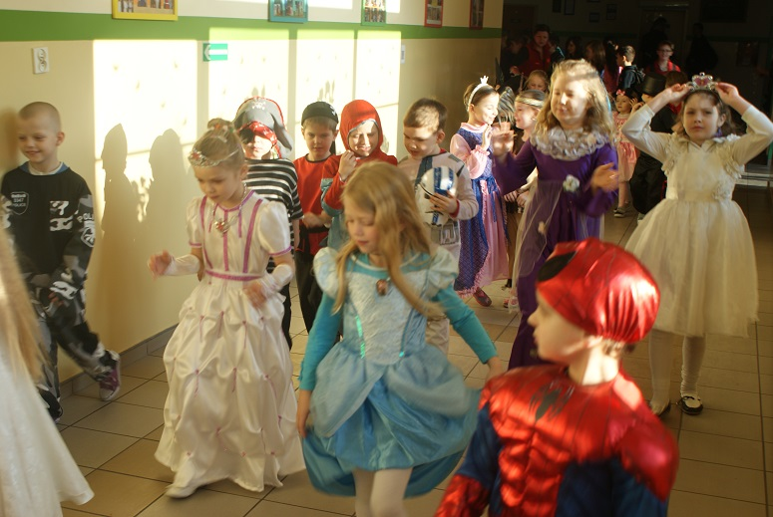

Slide 11
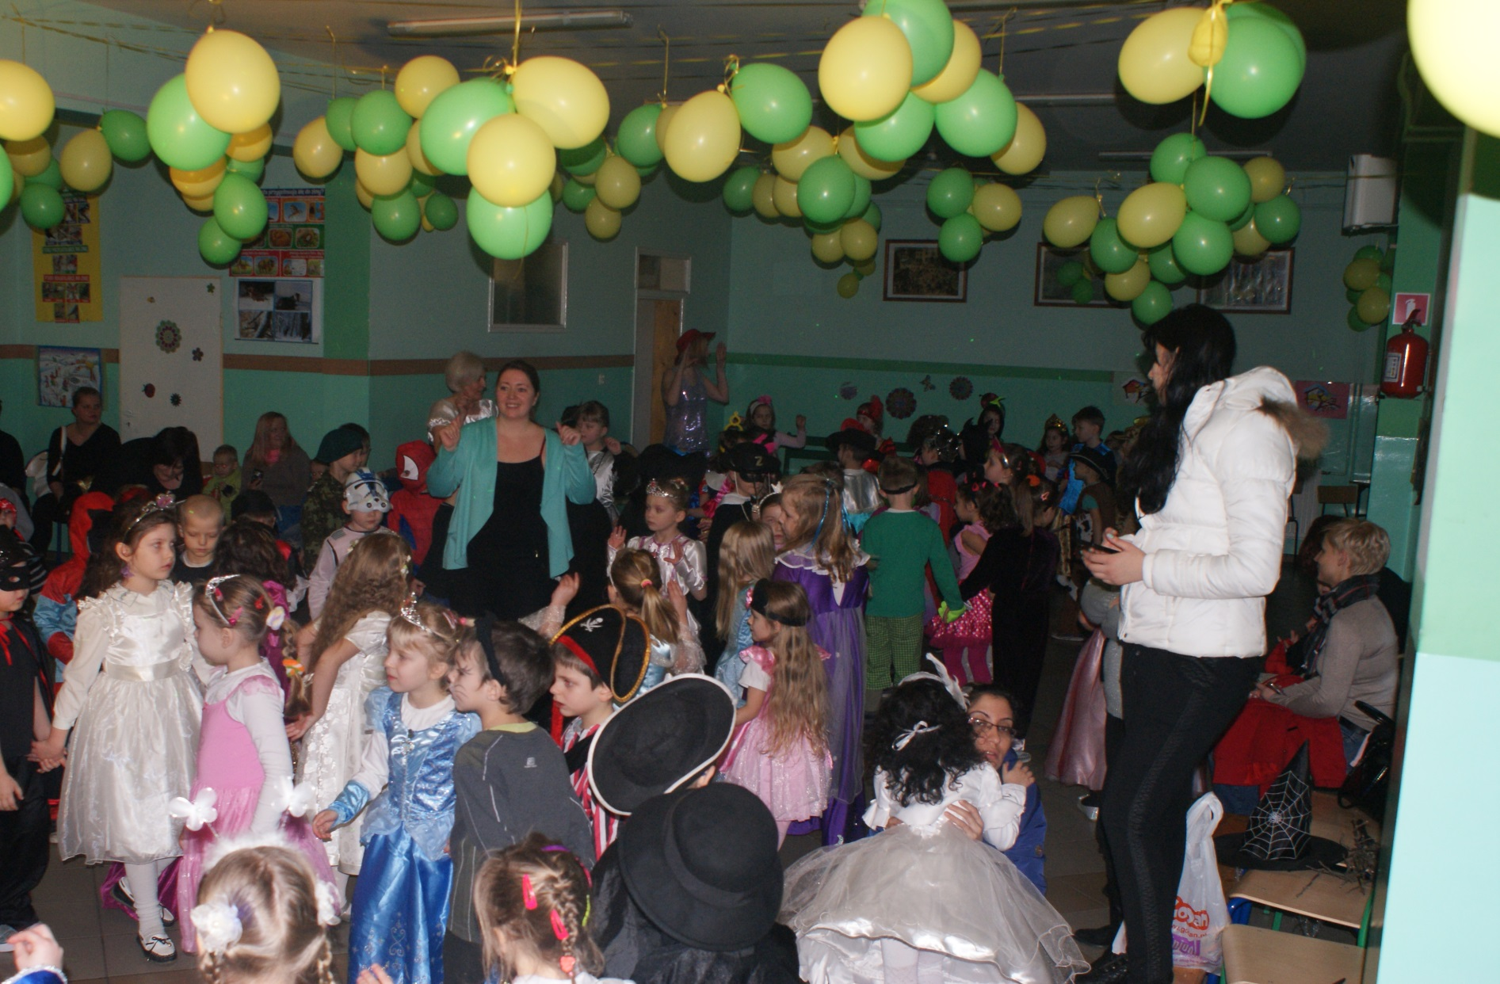

Slide 12
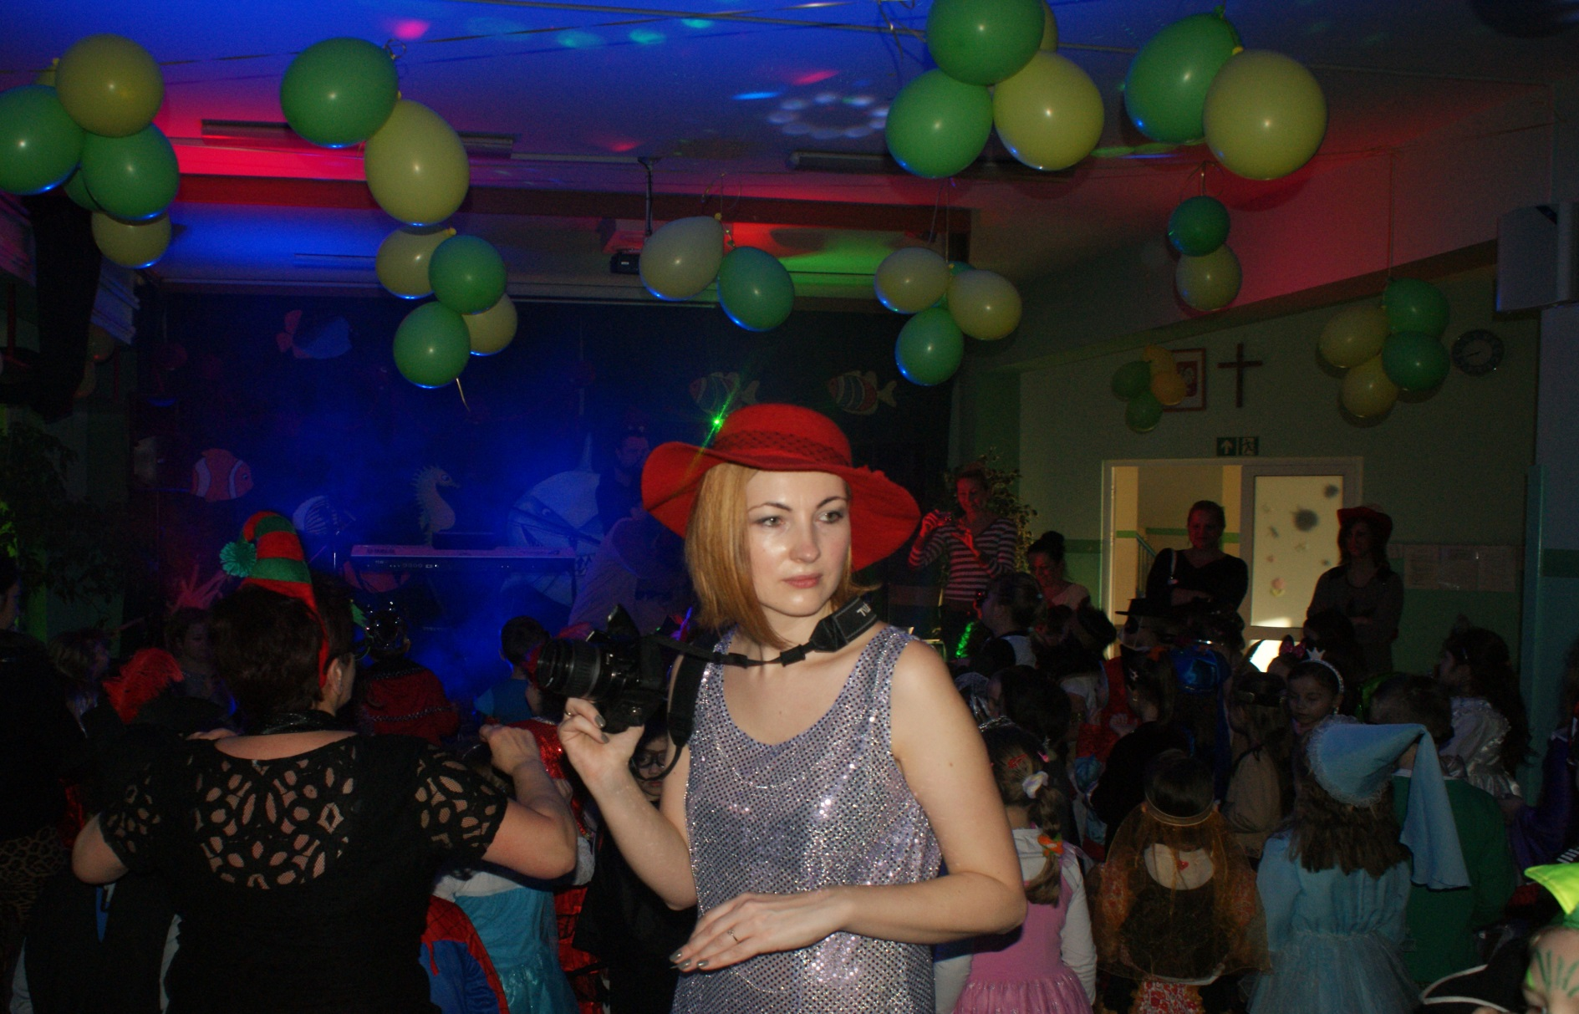

Slide 13
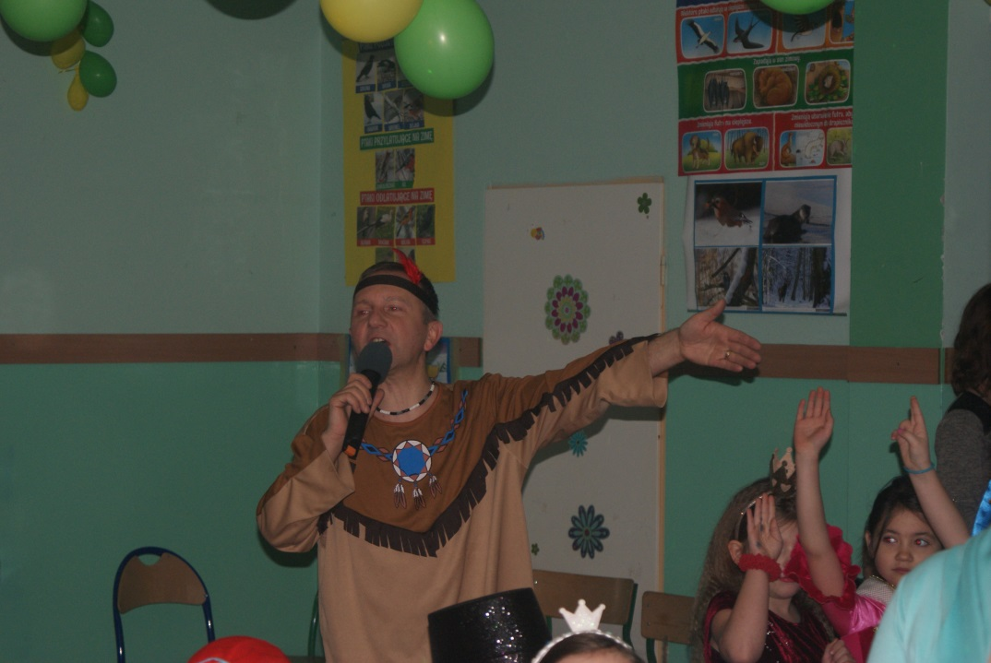
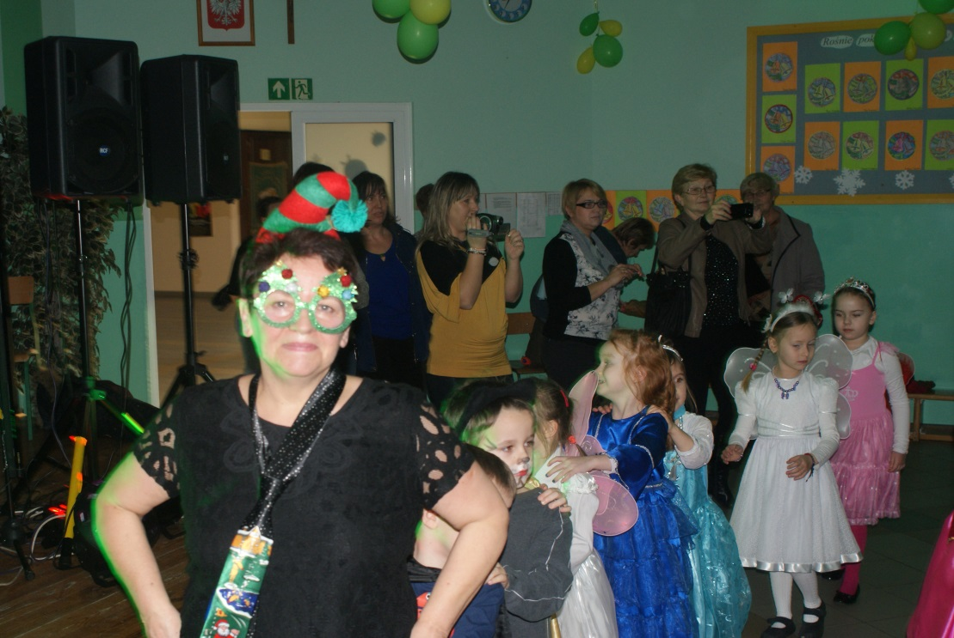
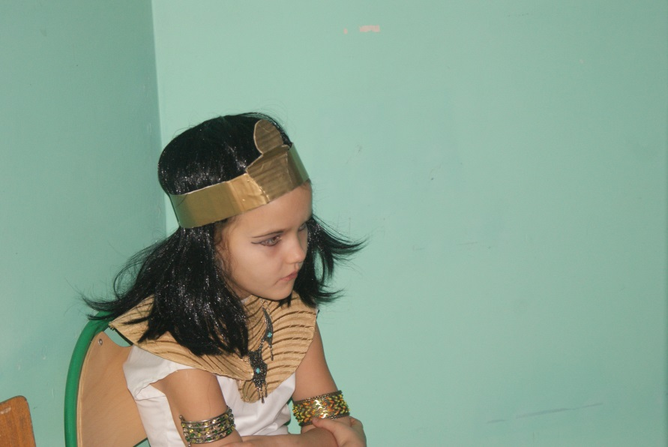

Slide 14
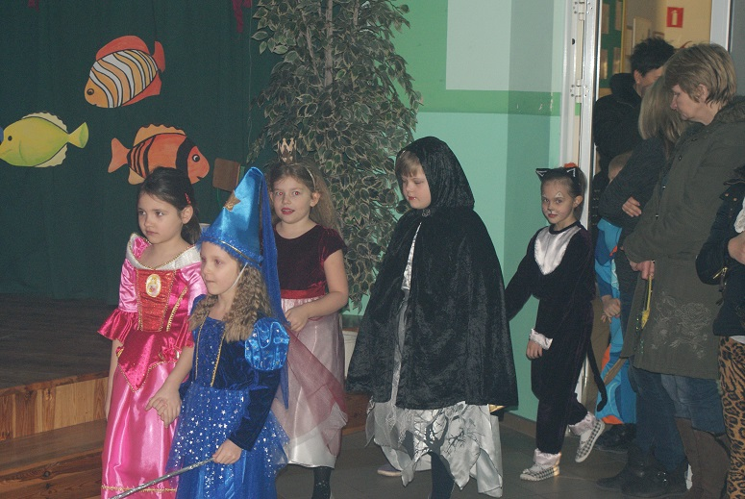

Slide 15
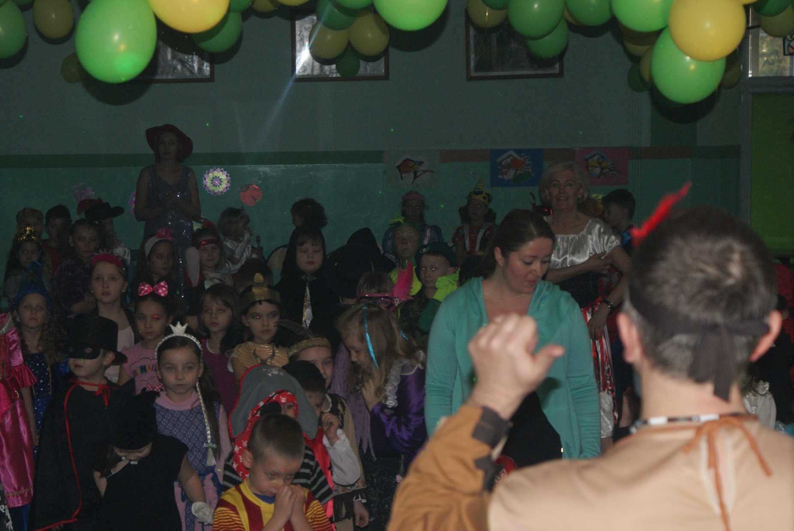

Slide 16
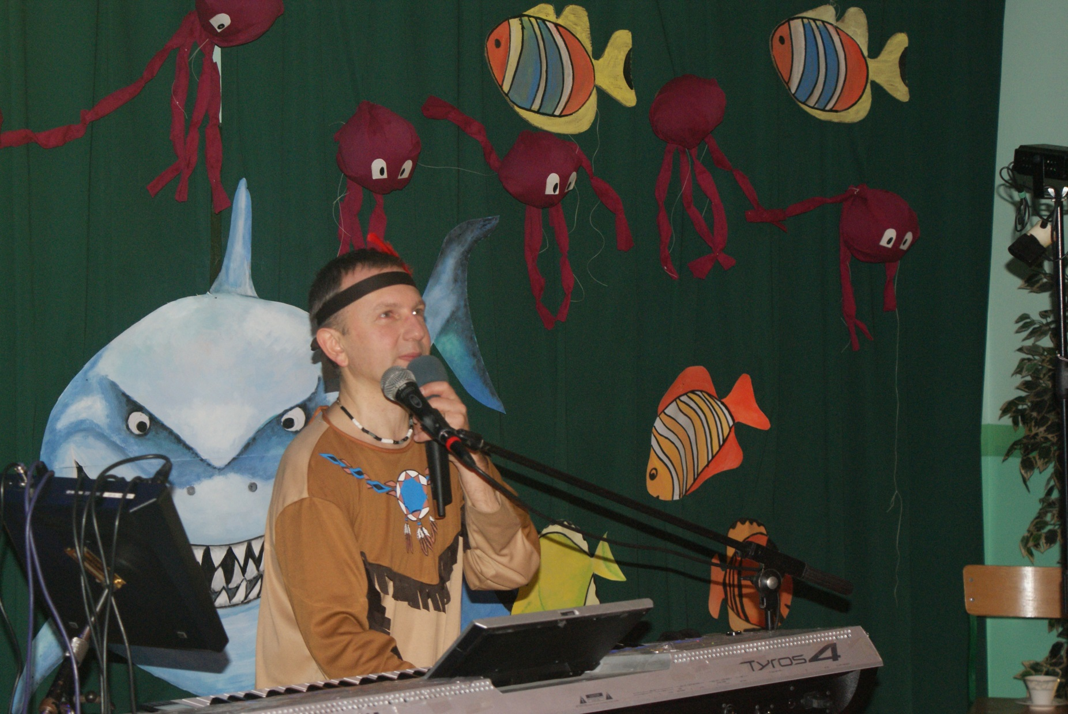

Slide 17
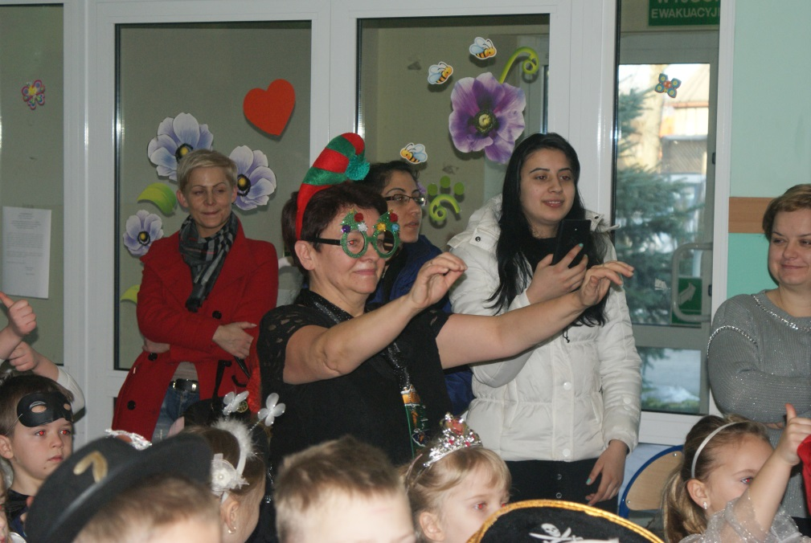

Slide 18
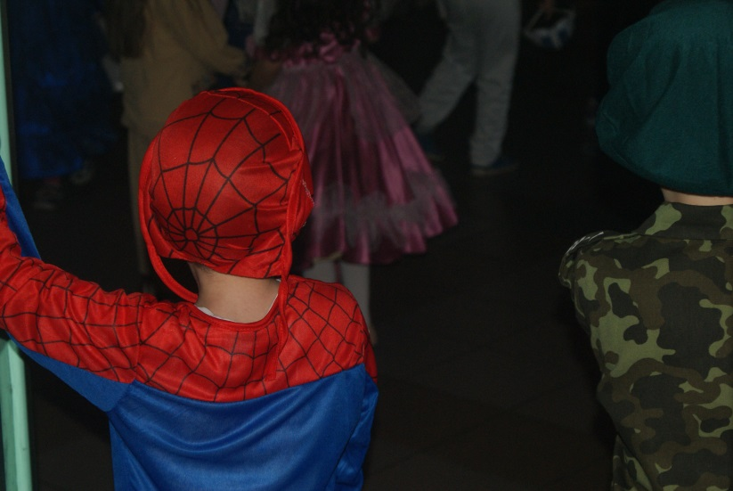
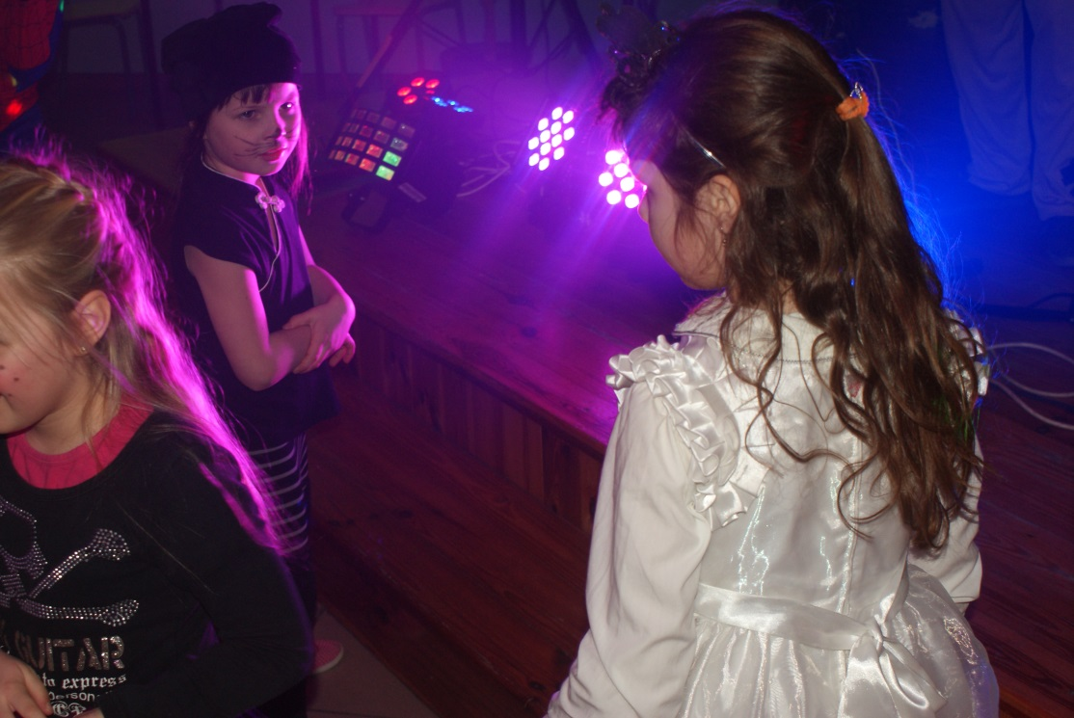
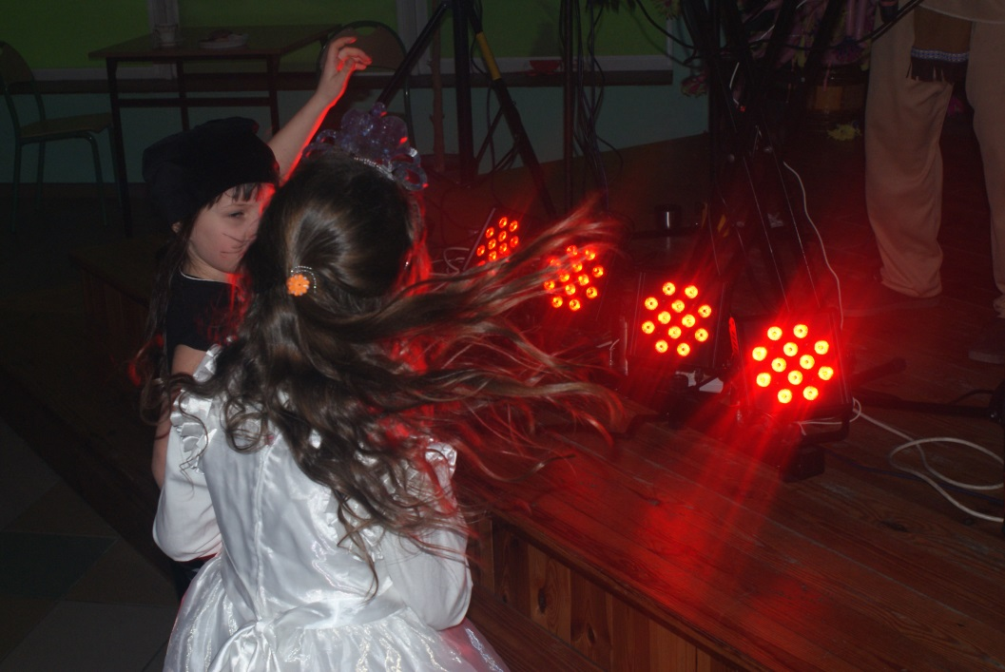
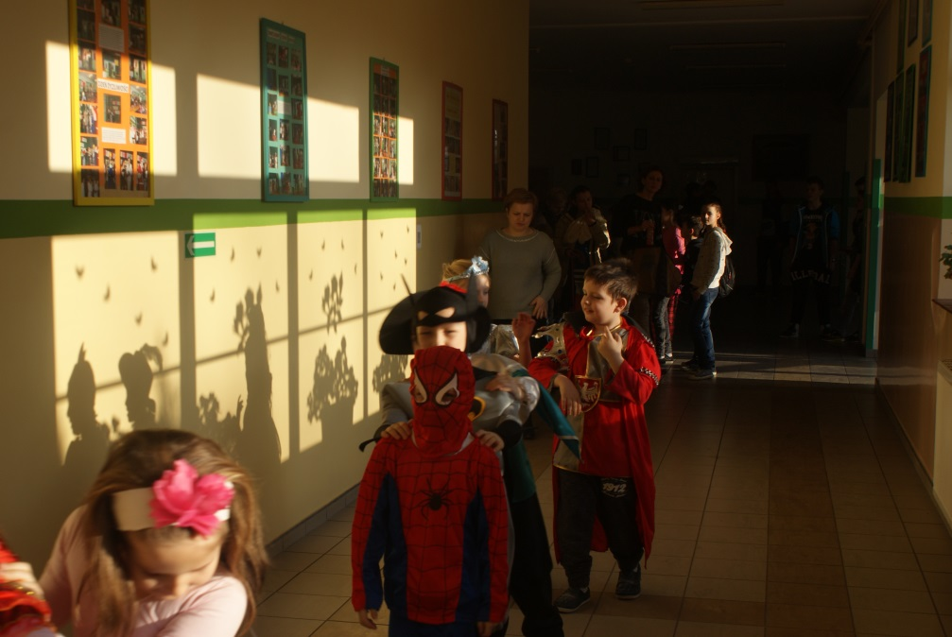

Slide 19
